Slide 1

Prosthetic Device
By: Cassandra, Michael, Peace, Samuel

Slide 2
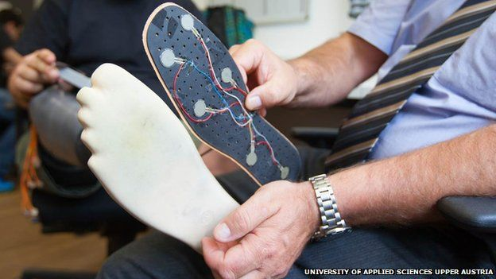
Device: Sensor Equipped Prosthetic Leg
Surgery required before receiving the prosthetic.
Composed of several components: prosthetic cast, sensors, microcontroller, and stimulators.
Creates sensation of feeling as user walks.
University of Applied Sciences Upper Austria. Artificial Leg Allows Patient to Feel. By Fergus Walsh.

Slide 3
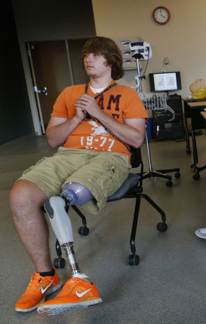
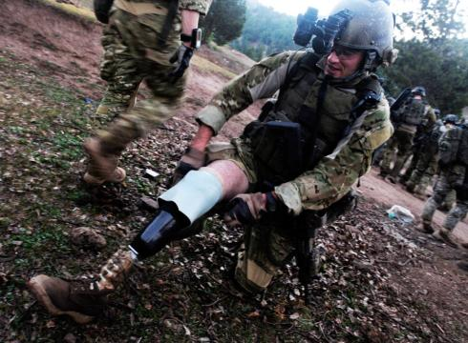
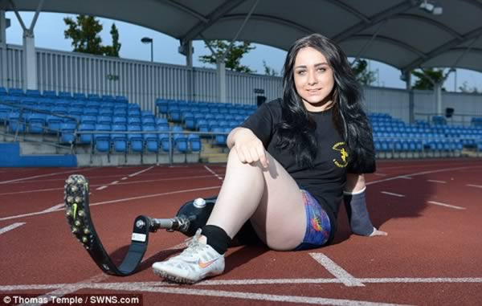
Importance

Slide 4
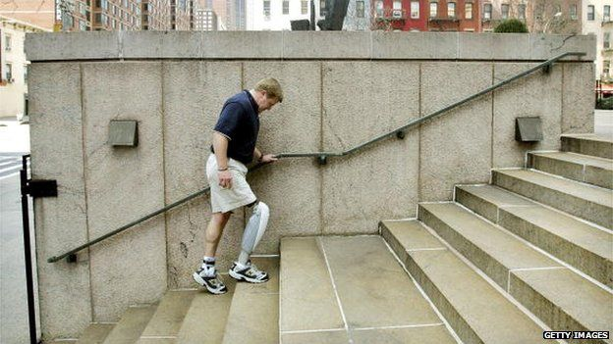
Importance
http://www.bbc.com/news/blogs-ouch-28225622

Slide 5
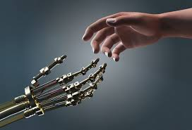
Hopes of Tomorrow
Each Person holds within them a self image that they perceive to be true. Destruction of that image can forever shatter the self, leaving but a husk of a man behind (Anonymous).
http://noahpinionblog.blogspot.com/2014/05/cyborg-tech-is-next-really-big-thing.html

Slide 6
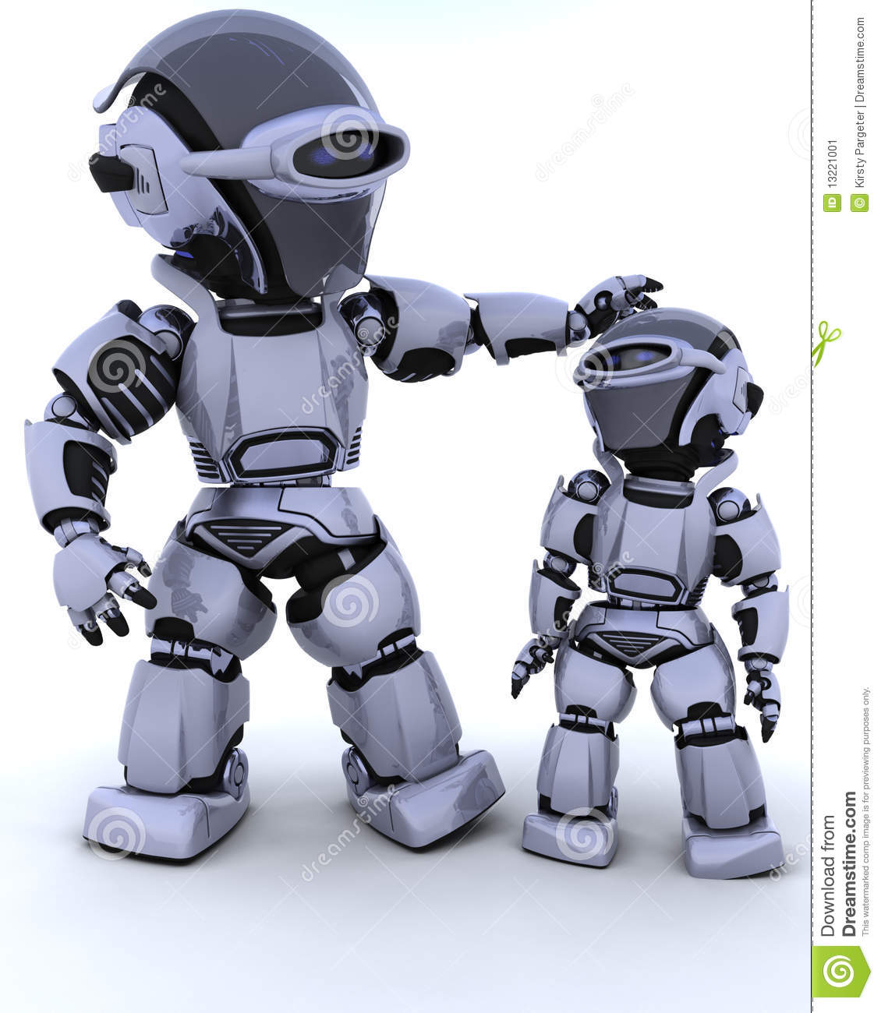
Nobody Knows Tomorrow Better Than Today
Always remember your origins lest you become something so unrecognizable that others no longer see you as human (Anonymous).
http://www.dreamstime.com/stock-image-cute-robot-cyborg-child-image13221001

Slide 7
Things To Consider
Possible Future Downsides of the device
A surgery is a surgery no matter how small
Easier to get a new limb than to save a dead one

